Slide 1
COMMUNITY BASED DISASTER RISK MANAGEMENT IN MALAYSIA:
Roles of ministry of women, family and community development
SOCIAL WELFARE DEPARTMENT OF MALAYSIA
Notes:
INTRODUCTION :
The Social Welfare Department is an agency under the Ministry of Women, Family and Community Development.
Victims of natural disaster is one of the main target group under the Social Welfare Department as well as other target groups such as person with disabilities, older person, family and children.

Slide 2
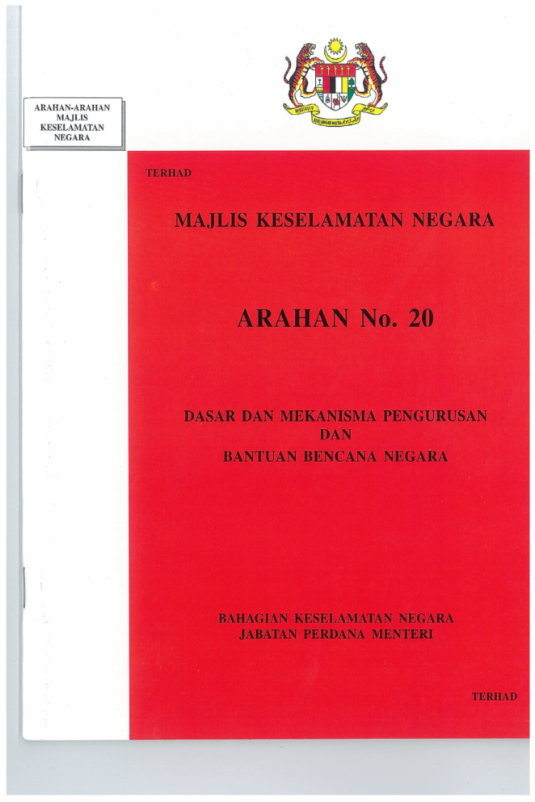

ROLES AND RESPONSIBILITIES OF
THE SOCIAL WELFARE DEPARTMENT
NATIONAL SECURITY COUNCIL (NSC)
Directive No. 20
PROVIDE AND MANAGE THE EVACUATION CENTRES
20 OKTOBER 15
22 DISEMBER 15
PREPARE AND DISTRIBUTE FOOD,
CLOTHING AND OTHER ESSENTIAL ITEMS
TO THE AFFECTED VICTIMS
(Semakan Semula)
11 NOVEMBER 15
11 OKTOBER 16
REGISTER THE DISASTER VICTIMS FOR THE PURPOSE OF REHABILITATION
PROVIDE GUIDANCE, ADVICE / COUNSELING SERVICES TO THE AFFECTED VICTIMS
MAJLIS KESELAMATAN NEGARA
Notes:
ROLE AND RESPONSIBILITIES OF THE SOCIAL WELFARE DEPARTMENT :
The roles and responsibilities are subject to the direction from the National Security Council Directive No. 20.
(follow the slide)
B. DISASTER RELIEF GOODS IN THE EVACUATION CENTRES :
BASIC REQUIREMENTS:
a) Mats
b) Blanket
c) Pelikat
d) Sarong
e) Towel
f) Comforter
g) Hygiene Kit – toothpaste, toothbrush, soap, face towels, shampoo, comb
h) Refreshment Kit – Drinks, biscuit packet/bread
2. FOODS :
Rice
Sugar
Cooking oil
Salted Fish
Coffee/tea
Egg
Salted fish
Canned food
Flour
Bee hoon
Drinking water
Condensed milk
Biscuits
Sardines
3. ADDITIONAL REQUIREMENTS:
Foam mat
wheelchair
T-shirts
Disposable Diapers (Adult / Child)
Track Pants (adult/child)
Pads
Under wear
Pillow
Candles
Milk powder (Baby/ senior citizen)
Mattress (special needs victims)
C. REGISTER THE DISASTER VICTIMS FOR THE PURPOSE OF REHABILITATION :
Registration of disaster victims is essential to ensure that they are given appropriate assistance at the Evacuation Centres and Long Term Disaster Assistance after they return to their homes.
There are various categories of assistance provided to disaster victims by either the Federal Government or the State Government. This support is also different between States in Malaysia.
D. PERKHIDMATAN INTERVENSI KRISIS DAN SOKONGAN PSIKOLOGIKAL :
Psychologist/Counselor of the Social Welfare Department will co-ordinate the Crisis Intervention Services and Psychological Support to the victims in the evacuation centres and further counselling after the victims return home.
This officer will work with counsellors from various agencies and volunteers to assist victims and offer the psychological support.

Slide 3
DISASTER MANAGEMENT MECHANISM BY SOCIAL WELFARE DEPARTMENT
Identified a total of 5,448 evacuation centres
Appoinment of managers and committee of the evacuation centres
Disaster relief and logistics facilities
Disaster training and simulation
Supply of basic food necessities
Disaster preparedness meeting
RESTORATION STAGE
(Post-Disaster)
DISASTER PREPAREDNESS
(Pre-Disaster)
Update and review the list of victims for recovery purposes
Intervention Crisis and psychological support by Psychologist and Counselors
Disaster’s Post-Mortem Meeting
Cleaning and community service by Soc Welfare Department’s volunteers
Opening and closing of the evacuation centres
Registration of disaster victims
Distribution of aid to victims
Mobilizing department’s staff, counselors and volunteers
Crisis Intervention Services and psychological support
Organize suitable activities for the evacuees in the evacuation centres
RESPONSE STAGE
(During Disaster)

Slide 4
“COMMUNITY EMPOWERMENT RESILIENCE DURING DISASTER”
Participation of community members at the Evacuation Centres/Depot/Stockpiles – Cooking /
Appoinment of Community Leader as a Supervisor of the Evacuation Centres
Appoinment of community members as the Evacuation Committee
COMMUNITY BASED DISASTER MANAGEMENT
Using expertise in the community– Establishment of the Psychological Support Team
Disaster Training and Simulation– Community involvement
Post-Disaster – Community involvement/volunteers/Govt Agencies / NGOS
Notes:
The appointment of the community leaders/ Head of Department/ Agency / Headmasters and other qualified as Coordinator in the Evacuation Centres:
a) community leaders more recognize and understand the socio-culture of their members in the communities;
b) they are influential and respected by community members.
2. Appointment of members of the community/departments in the district to be members of the Committee in the Evacuation Center :
a) community members have a better understand the needs in their own community;
b) More easier to get cooperation from members of the community in the management of activities in the Evacuation Centres.
3. The Social Welfare Department also organize Training and Simulated Disasters by engaging various agencies that involve in the management of the Evacuation Centres and also members of the community so that they are aware of the need for disaster preparedness.
4. Post Disaster Activities such as clearing disaster victim’s houses especially for the senior citizens and people with disabilities are given attention by the Social Welfare Department.
This activity will involve various government agencies, Voluntary bodies, Charitable, volunteer and members of the community itself. They will work cleaning up their homes and communities.
5. Using the expertise available in the community to manage the disaster victims either during the disaster or its aftermath.
For example:
a) The Social Welfare Department has set up the “Psychological Support Team” consisting of Psychological Officer or Counselor in the community to help the disaster victims that need psychological support or traumas after the disaster.
Participation of community members and victims of the disaster itself in helping in the Evacuation Centres activities are also strongly encouraged especially in cooking, hygiene, safety of the evacuation centres from any intrusions and nuisance.
Members of the community through Volunteers that are registered with the Social Welfare Department also placed in Depot or Store for helping to distributing food supplies and stocks.

Slide 5
Appointing the communities in the evacuation CENTRES
SUPERVISORS
Victim registration committee
Security committee
Volunteerism committee
Activity committee
Requirement supply committee
Health & hygiene committee
Food committee
Notes:
Appoinment of the Community Leaders as a Supervisor in the Evacuation Centers.
There are 7 Committees in the Evacuation Centres : ( As in the slides)

Slide 6

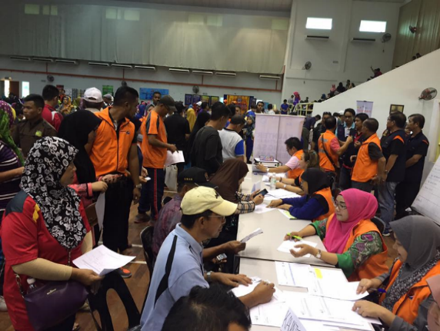
Involvement in disaster preparedness simulatioN
Notes:
We are involving the Community Leaders and members of the community in the Disaster Prepredness Simulation to make sure they are always in the prepredness situation.

Slide 7
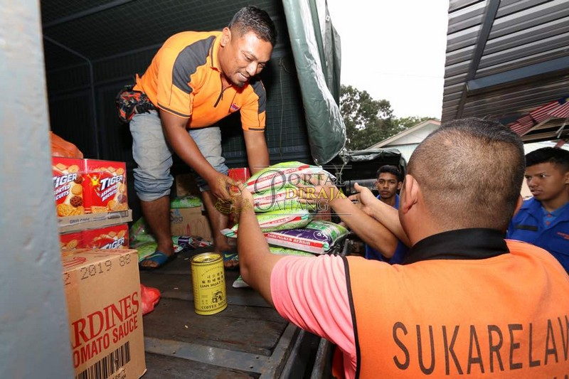
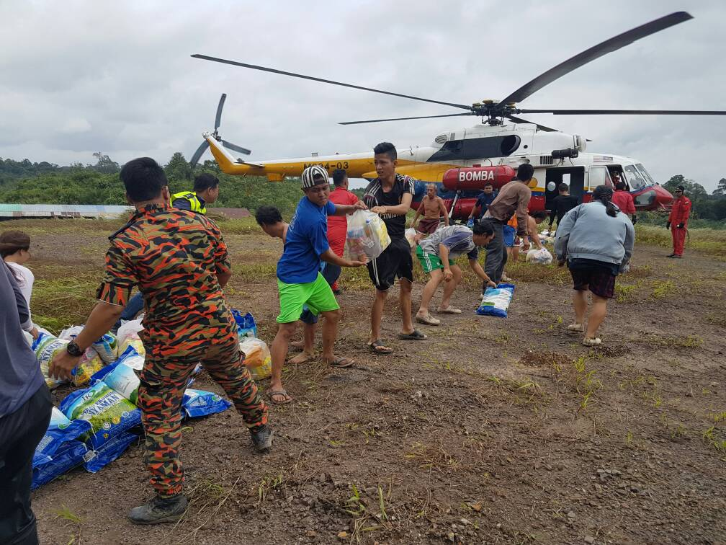
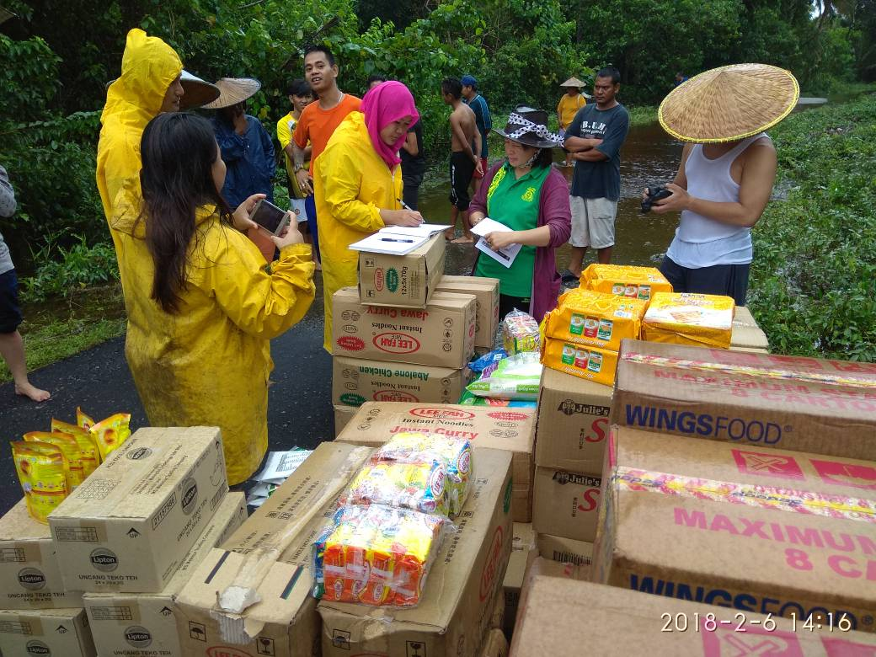
VolunteeRS at the evacuation centre / DEPOT / STOCKPILES

Slide 8
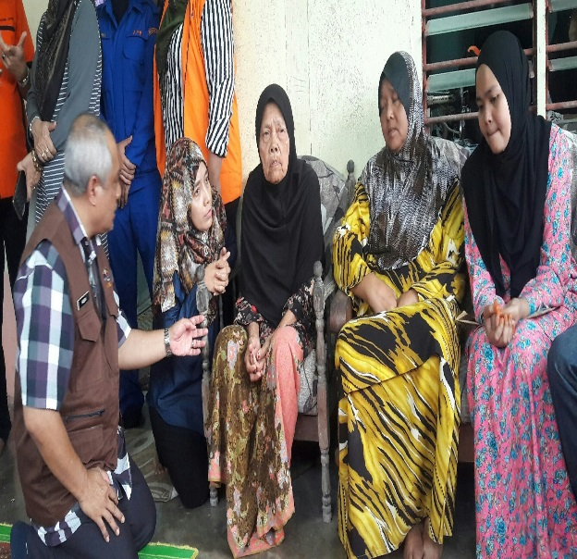
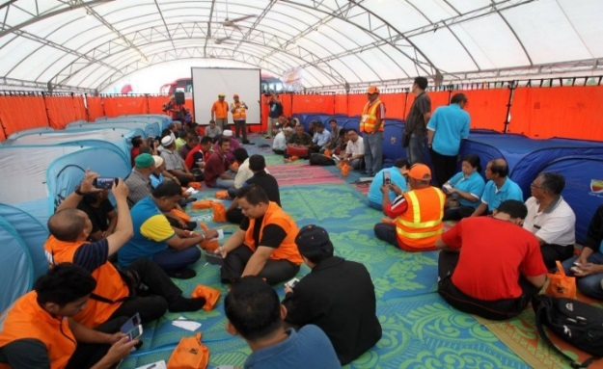
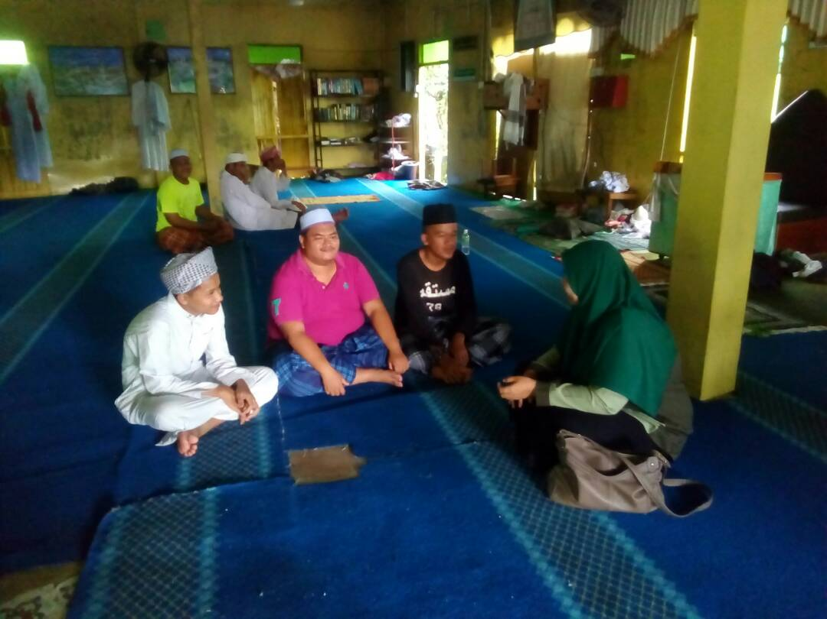
USING community expertise
Notes:
The participation of the Psychological Support Team in providing services to victims of a disaster.

Slide 9
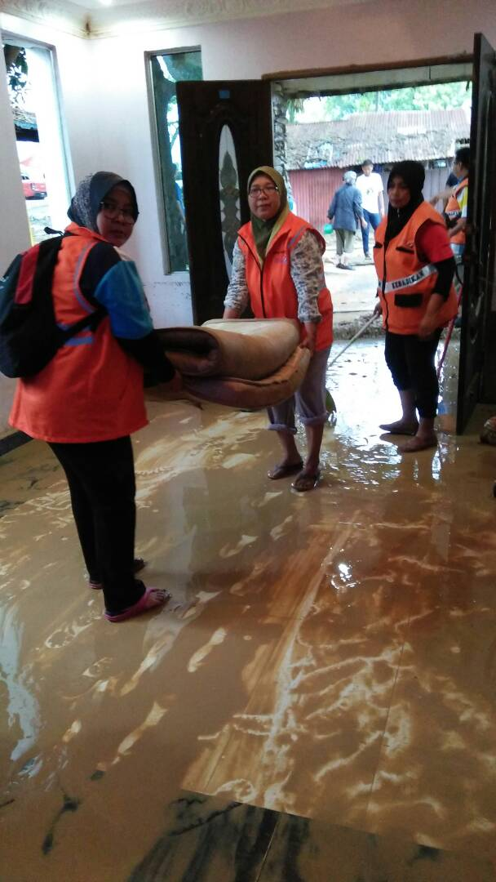
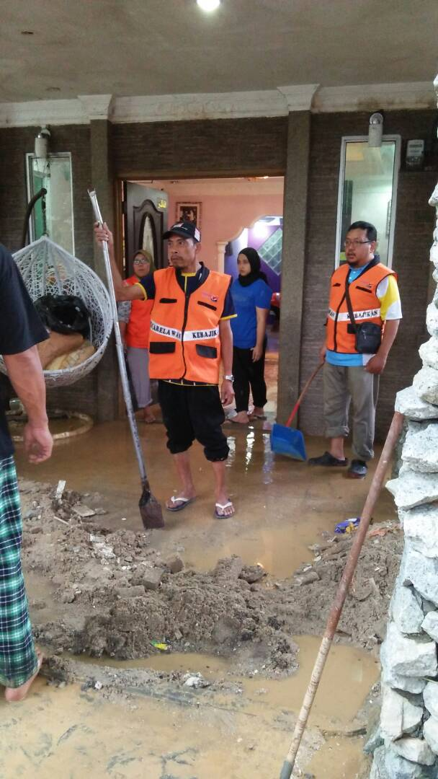
POST-DISASTER ACTIVITIES
Notes:
Volunteers who are registered with the Social Welfare Department will be mobilized in volunteer activities after the disaster.

Slide 10
Issues and challenges:
VOLUNTEERS are not Our permanent STAFF – need to ATTEND their official duties during disaster period
do not understand the role and duties of the Department – NEED MORE exposure and training
DON’t HAVE SPECIALITIES AS A VOLUNTEER - allowances/uniform/insurance ETC
time Constraints to be a volunteer

Slide 11


