Slide 1
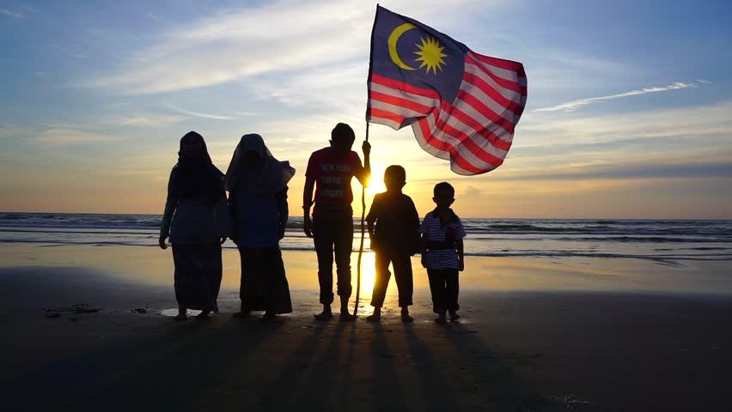
NATIONAL DISASTER MANAGEMENT AGENCY
Prime Minister Department, Malaysia
DISASTER LANDSCAPE IN MALAYSIA AND CHALLENGES FOR BUILDING NATIONAL RESILIENCE
Keynote Address by:
YBhg. Dato’ Mohtar Mohd Abd Rahman
Director General
Malaysia Disaster Management Agency (NADMA)

Slide 2
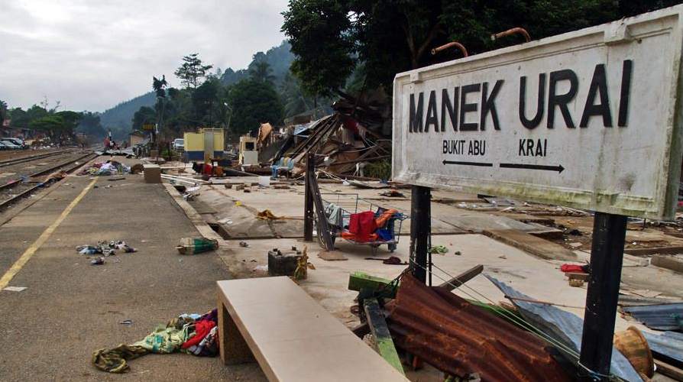
YELLOW FLOOD
WORST MONSOON FLOOD
Cabinet considered the memorandum of the Prime Minister dated 26th August 2015 agreed :
“the establishment of the National Disaster Management Agency (NADMA) under the Prime Minister’s Department taking over the responsibility from the National Security Council.”
NADMA officially formed on 1st October 2015 with the consolidation of the Disaster Management Division of the National Security Council, Post-Flood Recovery Unit of the Prime Minister’s Department and the Special Malaysia Disaster Assistance and Rescue Agency (SMART)

Slide 3
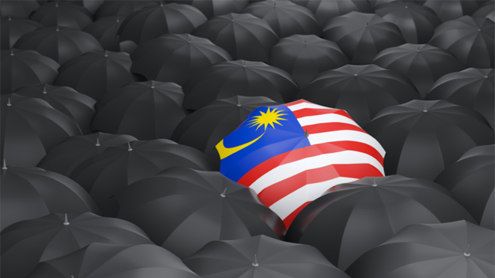
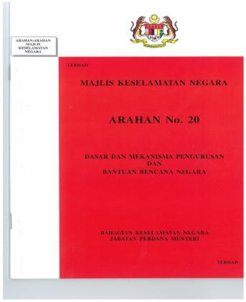
NDM ALLUSION
POLICIES & MANAGEMENT MECHANISM
(Semakan Semula)
10
PARTS
27
MAJLIS KESELAMATAN NEGARA
CHAPTERS

Slide 4
RESPONSE MECHANISME
DISASTER MANAGEMENT
State Disaster Management Committee
Headed by the State Secretary
Provide assistance to the affected area such as financial aid, assets & human resources
District Disaster Management Committee
Headed by the District Officer
Ensure that coordinated action, sufficient assets and human resources, in relation to media
Headed by the Deputy Prime Minister
Central Disaster Management Committee
Determining the national disaster management policy, asset, financial and human resources

Slide 5
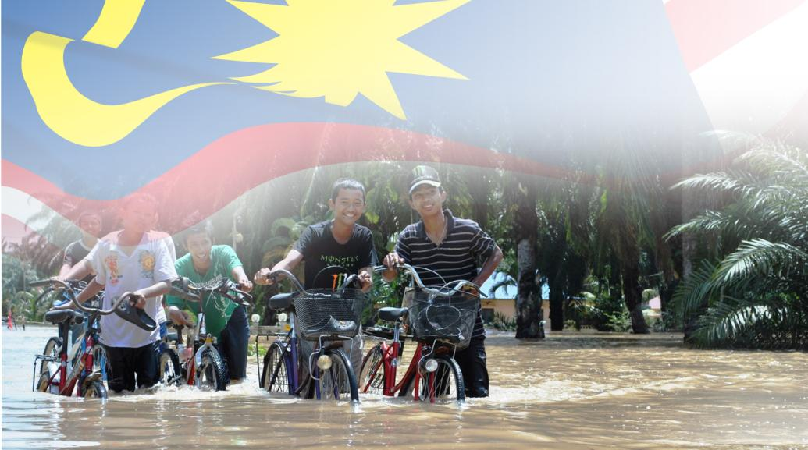
DEFINITION
UNISDR
NSC DIRECTIVE N0.20
"a serious disruption of the functioning of a community or society involving widespread human, material, economic or environmental losses and impacts, which exceeds the ability of the affected community or society to cope with using its own resources”.
"an event that cause disruption to the community and country’s activities, loss of life and property, damages to the economy and environment which surpass the affected local community’s ability and capacity and require extensive resource mobilization to cope with ”.

Slide 6
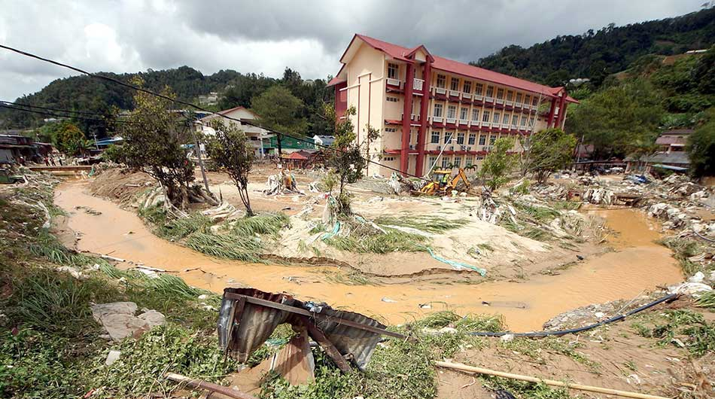
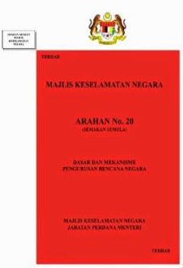
Sudden & Complex Incidence
Hazards
Becoming Disaster
Affects lives, properties, activities and environment
Requires extensive resources, skills & equipment
Multi-agencies coordination and actions
National Security Council Directive No.20
(Revised)
Policy and National Disaster Management Mechanism
Notes:
UNISDR define hazards as:
a process, phenomenon or human activity that may cause loss of life, injury or other health impacts, property damage, social and economic disruption or environmental degradation. Hazards may be natural, anthropogenic or socio natural in origin (UNISDR, 2016).
So when hazards become disaster?
According to National Security Council No.20, disaster has been defined as:
a serious disruption of the functioning of a community or a society involving widespread human, material, economic or environmental losses and impacts, which exceeds the ability of the affected community to cope using its own resources”
The effect of the disaster can be immediate and localized but is often widespread and could last for a long period of time.
The effect as exceeding the capacity of the community or society to cope with their own resources, and therefore may require assistance from external sources, which could include neighbouring jurisdictions, or those at the national or international level

Slide 7
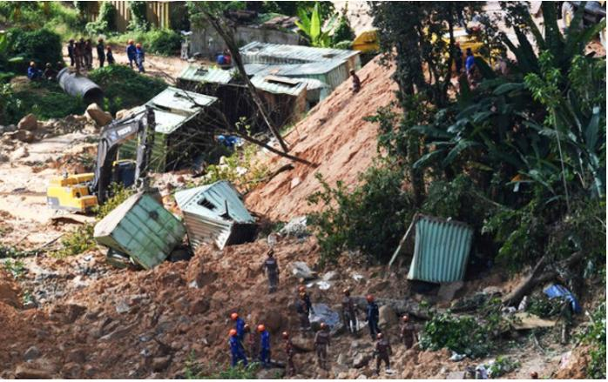
DISASTROUS INCIDENTS
12
DISASTROUS
INCIDENTS
Natural disaster
Industrial disaster
Accident with hazardous material
Collapse of high-rise structure
Air accident in high density population
Train collision or derailment
Fire outbreak in large area or high-rise
Reservoir burst
Chemical, bio or radiological accident
Haze jeopardizing public order, economy and govt. admin
Pandemic diseases outbreak
Others declared by govt.

Slide 8
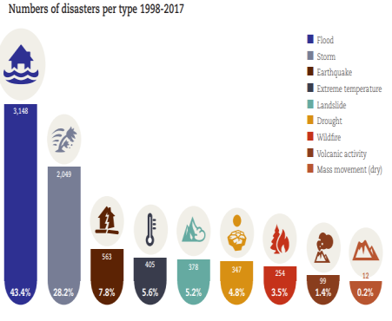
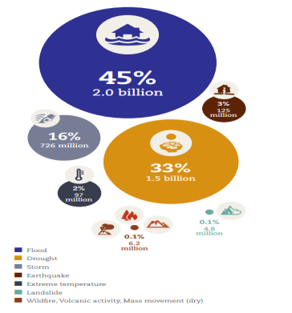
GLOBAL DISASTER LANDSCAPE
Numbers of disaster 1998-2017
Number of people affected 1998-2017

Slide 9
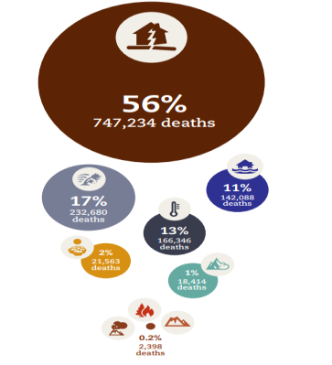
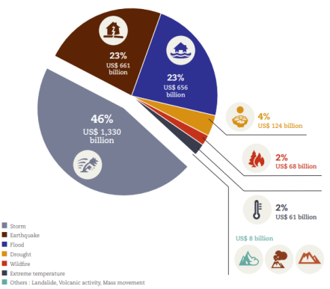
GLOBAL DISASTER LANDSCAPE
Economic losses (USD) 1998-2017
Numbers of deaths 1998-2017

Slide 10
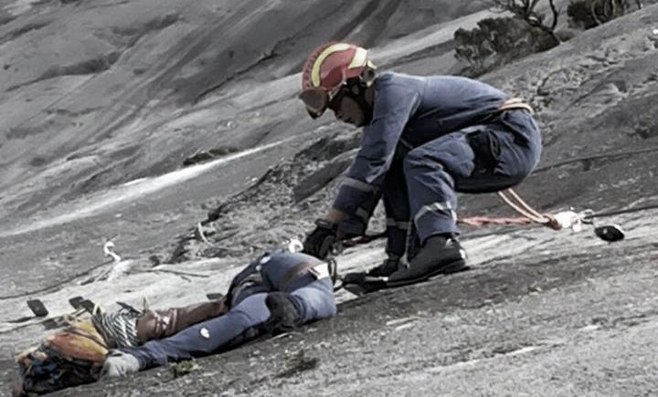
SABAH EQ 2015

Slide 11
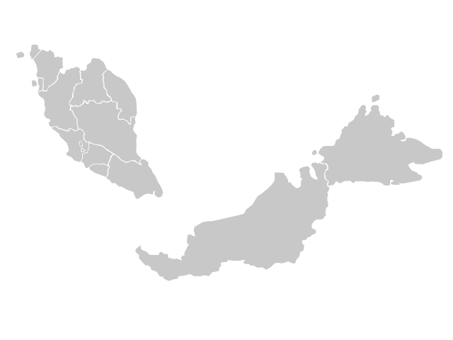
MALAYSIA DISASTER LANDSCAPE
* The Earth Institute of Columbia University

Slide 12
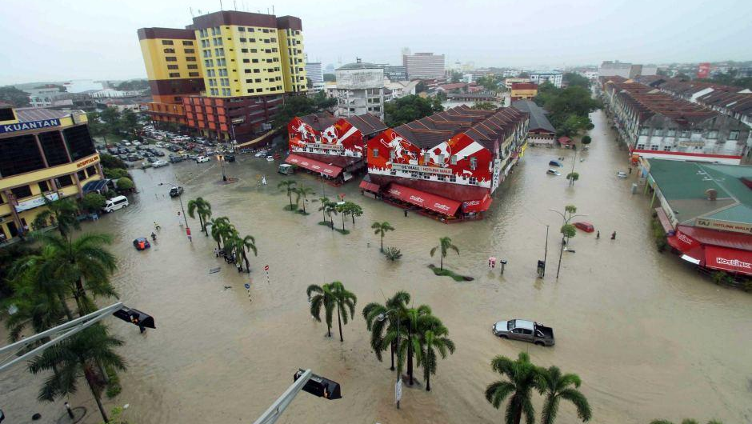
Floods
are the primary hazard affecting Malaysia, ranking at the top for most of the states in the country

Slide 13
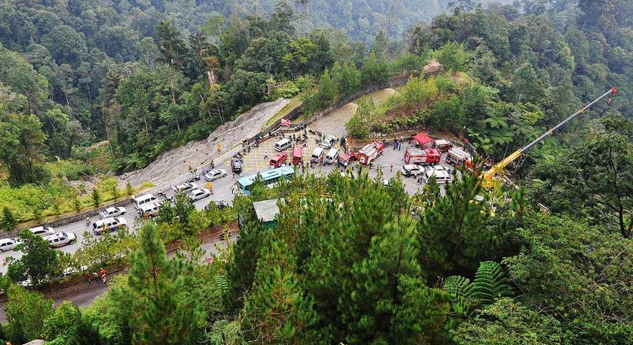
Landslides & Storms are also significant though their effects are limited to much smaller areas all over the country

Slide 14
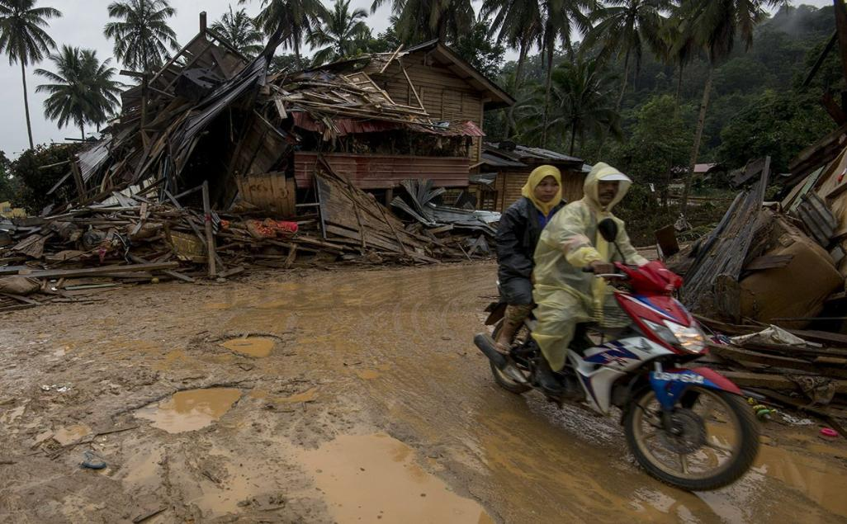
11th Malaysia Plan (2015-2020)
Governance
Resilience in Disaster Management
Science & Technology
Understanding the Risk
Partnership & Cooperation
Education & Awareness
Notes:
The Sendai Framework was adopted at the Third World Conference on Disaster Risk Reduction (WCDRR), held in March 2015 in Sendai, Japan
It was endorsed by the UN General Assembly following the 2015 Third UN World Conference on Disaster Risk Reduction
This is not a legally binded agreement but it is an instrument for all United Nations member states to refer in order to build resilience to natural and human-caused hazards.
With 4 priority of action- Malaysia also using this instrument as intervention mechanism and promoting the disaster risk reduction by
Understanding the risk – promoting the efforts to understand the risk through risk assessment, development of hazard and risk map for example and improved the management by scientific inputs.
Strengthening the government – the establishment of NADMA is one of the effort done by the government to enhance the management and disaster management. Institutional framework, financial, resources as well as laws and regulations helps us to strengthen the disaster governance
Investing in DRR- refers to structural and non-structural, promoting public private partnership and introduce to risk-transfer for example more open to risk insurance penetration.
Preparedness and build back better – encourage to enhance disaster preparedness for effective response for example improve the early warning system, information dissemination, and “build back better” in recovery, rehabilitation and reconstruction.

Slide 15
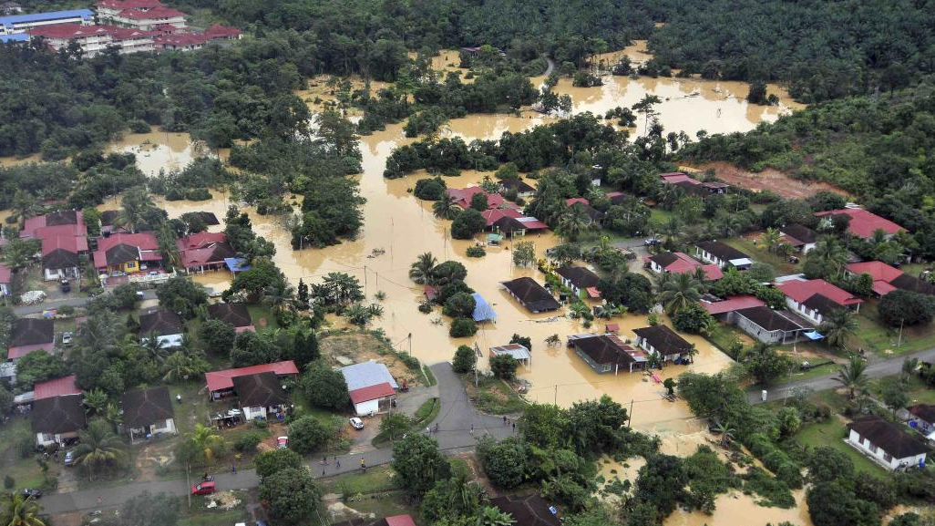
Organizational, Legal & Policy
Awareness
Challenges
Complexity
Resilience Measurement
International Cooperation
Notes:
The Sendai Framework was adopted at the Third World Conference on Disaster Risk Reduction (WCDRR), held in March 2015 in Sendai, Japan
It was endorsed by the UN General Assembly following the 2015 Third UN World Conference on Disaster Risk Reduction
This is not a legally binded agreement but it is an instrument for all United Nations member states to refer in order to build resilience to natural and human-caused hazards.
With 4 priority of action- Malaysia also using this instrument as intervention mechanism and promoting the disaster risk reduction by
Understanding the risk – promoting the efforts to understand the risk through risk assessment, development of hazard and risk map for example and improved the management by scientific inputs.
Strengthening the government – the establishment of NADMA is one of the effort done by the government to enhance the management and disaster management. Institutional framework, financial, resources as well as laws and regulations helps us to strengthen the disaster governance
Investing in DRR- refers to structural and non-structural, promoting public private partnership and introduce to risk-transfer for example more open to risk insurance penetration.
Preparedness and build back better – encourage to enhance disaster preparedness for effective response for example improve the early warning system, information dissemination, and “build back better” in recovery, rehabilitation and reconstruction.

Slide 16
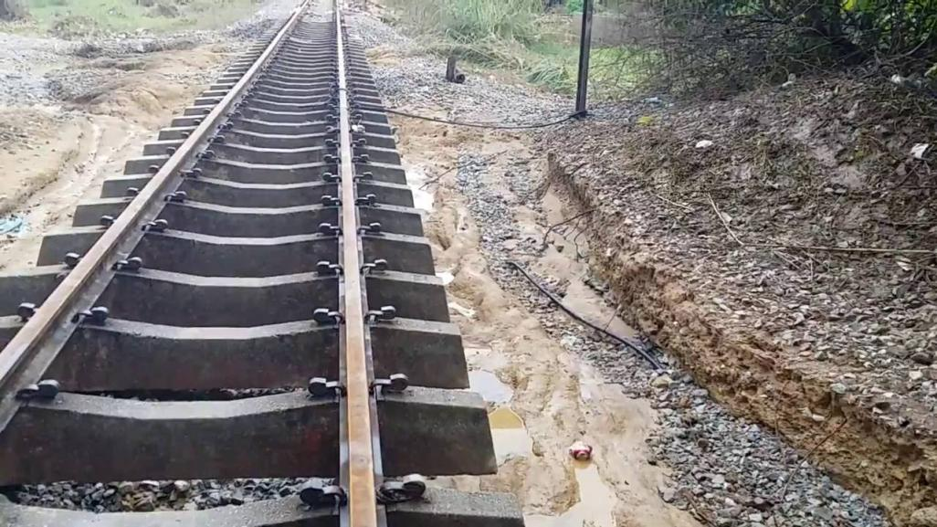
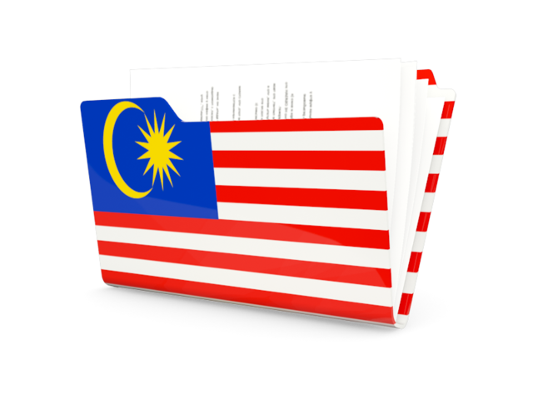
WAY FORWARD
Adequate legislation
Coordination with stakeholders
DRR awareness
Disaster preparedness
International & national cooperation

Slide 17
THANK YOU

